Slide 1
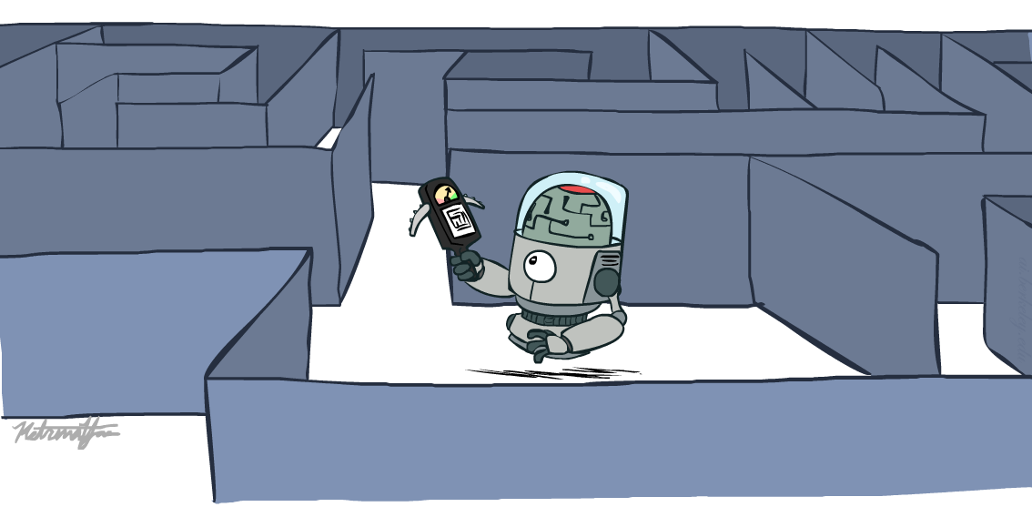
Fundamentals of Artificial Intelligence
Informed Search
Instructor: Dr. Hatim Alsuwat
Umm Al-Qura University

Slide 2
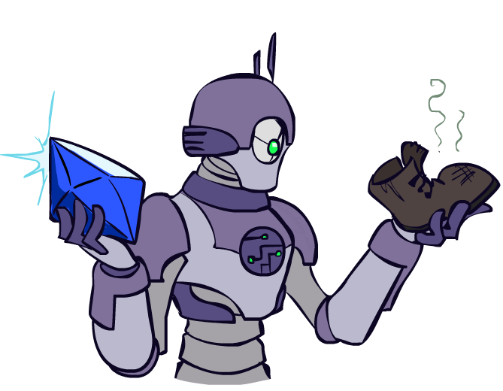
Today
Informed Search
Heuristics
Greedy Search
A* Search

Slide 3

Recap: Search

Slide 4
Recap: Search
Search problem:
States (configurations of the world)
Actions and costs
Successor function (world dynamics)
Start state and goal test
Search tree:
Nodes: represent plans for reaching states
Plans have costs (sum of action costs)
Search algorithm:
Systematically builds a search tree
Chooses an ordering of the fringe (unexplored nodes)
Optimal: finds least-cost plans

Slide 5
Example: Pancake Problem
Cost: Number of pancakes flipped

Slide 6
Example: Pancake Problem
State space graph with costs as weights
4
2
3
2
3
4
3
4
2
3
2
2
4
3

Slide 7
General Tree Search
Action: flip top two Cost: 2
Action: flip all four Cost: 4
Path to reach goal:
Flip four, flip three
Total cost: 7

Slide 8

Uninformed Search

Slide 9
Uniform Cost Search
Strategy: expand lowest path cost
The good: UCS is complete and optimal!
The bad:
Explores options in every “direction”
No information about goal location
c ≤ 1
…
c ≤ 2
c ≤ 3
Start
Goal
[Demo: contours UCS empty (L3D1)]
[Demo: contours UCS pacman small maze (L3D3)]

Slide 10

Video of Demo Contours UCS Empty

Slide 11
Video of Demo Contours UCS Pacman Small Maze

Slide 12
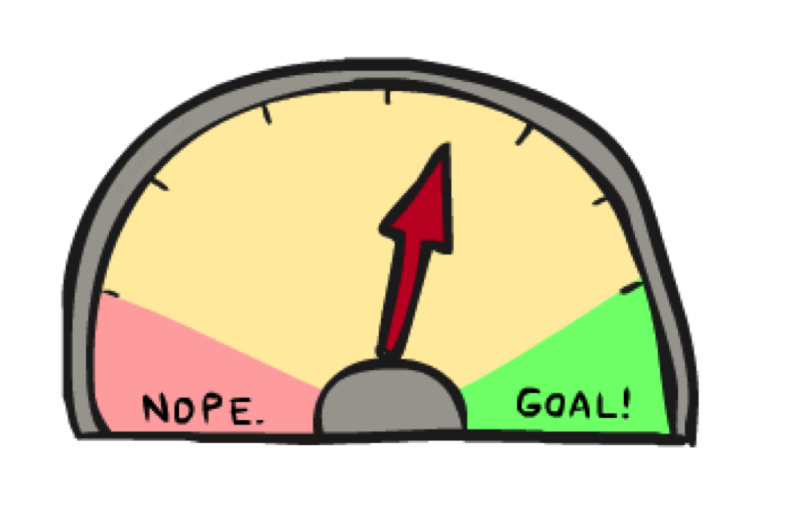
Informed Search

Slide 13



Search Heuristics
A heuristic is:
A function that estimates how close a state is to a goal
Designed for a particular search problem
Examples: Manhattan distance, Euclidean distance for pathing
10
5
11.2

Slide 14
Example: Heuristic Function
h(x)

Slide 15
Example: Heuristic Function
Heuristic: the number of the largest pancake that is still out of place
3
h(x)
4
3
4
3
0
4
4
3
4
4
2
3

Slide 16

Greedy Search

Slide 17
Example: Heuristic Function
h(x)

Slide 18
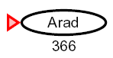

Greedy Search
Expand the node that seems closest…
What can go wrong?

Slide 19
Greedy Search
b
Strategy: expand a node that you think is closest to a goal state
Heuristic: estimate of distance to nearest goal for each state
A common case:
Best-first takes you straight to the (wrong) goal
Worst-case: like a badly-guided DFS
…
b
…
[Demo: contours greedy empty (L3D1)]
[Demo: contours greedy pacman small maze (L3D4)]

Slide 20
Video of Demo Contours Greedy (Empty)

Slide 21
Video of Demo Contours Greedy (Pacman Small Maze)

Slide 22
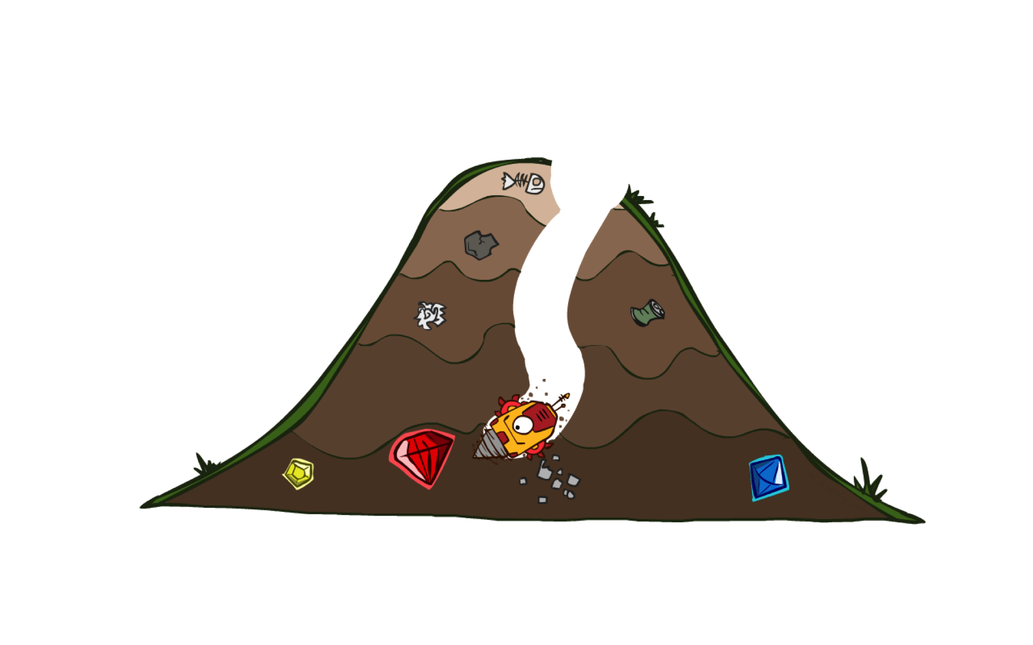
A* Search

Slide 23
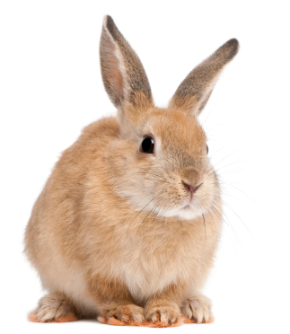
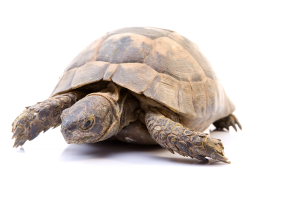
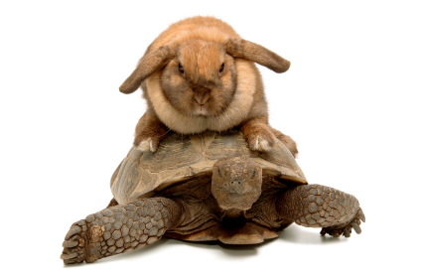
A* Search
UCS
Greedy
A*

Slide 24
Combining UCS and Greedy
Uniform-cost orders by path cost, or backward cost g(n)
Greedy orders by goal proximity, or forward cost h(n)
A* Search orders by the sum: f(n) = g(n) + h(n)
8
g = 0 h=6
S
e
h=1
g = 1 h=5
a
1
1
3
2
g = 2 h=6
g = 9 h=1
S
a
d
G
b
d
g = 4 h=2
e
h=6
1
h=5
h=2
h=0
1
g = 3 h=7
g = 6 h=0
g = 10 h=2
c
b
c
G
d
h=7
h=6
g = 12 h=0
G
Example: Teg Grenager

Slide 25
When should A* terminate?
Should we stop when we enqueue a goal?
No: only stop when we dequeue a goal
h = 2
A
2
2
S
h = 3
h = 0
G
2
B
3
h = 1

Slide 26
Is A* Optimal?
h = 6
1
A
3
S
h = 7
G
h = 0
5
What went wrong?
Actual bad goal cost < estimated good goal cost
We need estimates to be less than actual costs!

Slide 27

Admissible Heuristics

Slide 28

Idea: Admissibility
Inadmissible (pessimistic) heuristics break optimality by trapping good plans on the fringe
Admissible (optimistic) heuristics slow down bad plans but never outweigh true costs

Slide 29


Admissible Heuristics
A heuristic h is admissible (optimistic) if:
where is the true cost to a nearest goal

Slide 30
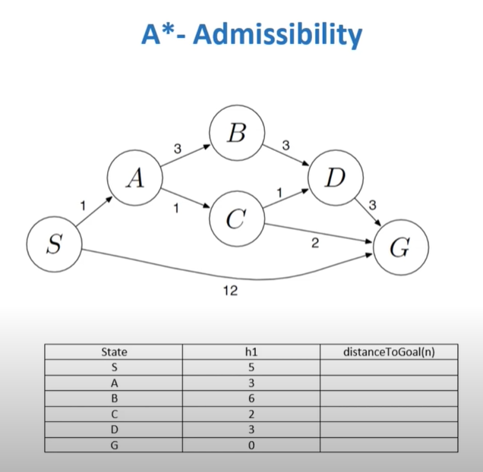
Admissible Heuristics Example
h(n) ≤ distanceToGoal(n)

Slide 31
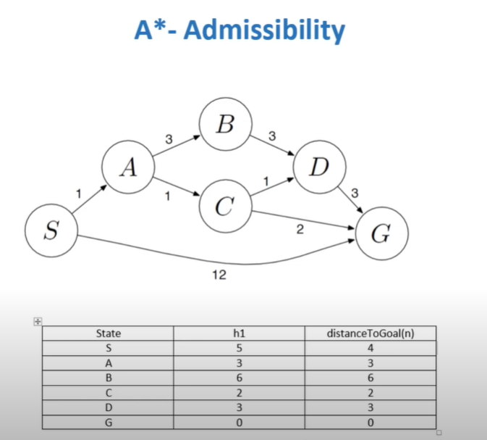
Admissible Heuristics Example
A* is not Admissible. So it is not optimal.

Slide 32
Properties of A*

Slide 33
Properties of A*
Uniform-Cost
A*
b
b
…
…

Slide 34
UCS vs A* Contours
Uniform-cost expands equally in all “directions”
A* expands mainly toward the goal, but does hedge its bets to ensure optimality
Start
Goal
Start
Goal
[Demo: contours UCS / greedy / A* empty (L3D1)]
[Demo: contours A* pacman small maze (L3D5)]

Slide 35
Video of Demo Contours (Empty) -- UCS

Slide 36
Video of Demo Contours (Empty) -- Greedy

Slide 37
Video of Demo Contours (Empty) – A*

Slide 38



Comparison
Greedy
Uniform Cost
A*

